Slide 2
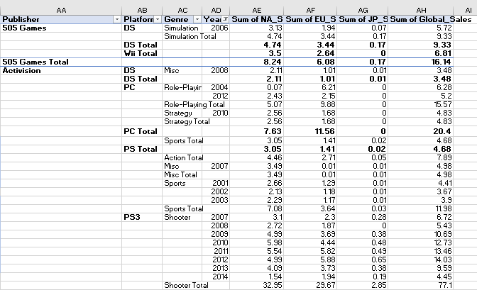
Data Analysis Techniques
The techniques used are data cleaning, pivot tables, and graphing.
Data cleaning is the process of removing incorrect, duplicate, or incomplete data within a dataset. It is relevant in ensuring data integrity and consistency which make the dataset ready for analysis.
Pivot tables are tools for summarizing and analyzing data.
In this case, the pivot table is utilized to examine sales figures using the publisher as the main category, then the year, genre and total sales of the regions like North America, Europe, Japan and global sales.
Using pivot tables is relevant for providing valuable insights into the competition among publishers within the dataset and help understand their market share and performance.
Graphing makes the data easily readable and draws reader attention because it use visual representation of data.
Figure of Pivot Table sample

Slide 3
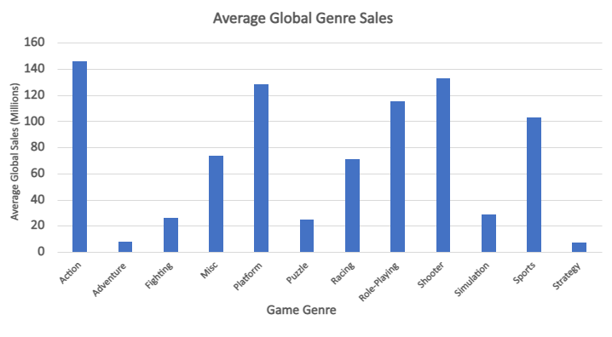
Results and Interpretation
The main goal or aim of this data analysis is to find out which genre of the video game do customers enjoy and was the highest selling.
The results include insights into 16,600 video games, sales figures for NA, EU, JP, and global regions, and competition among publishers from the same company.
From this example we work on calculating the mean sales between all the regions by genre.
Our conclusion suggests that globally people are almost 20 times more likely to play "Action" games compared to "Strategy" games.
Figure 1. Bar Chat of Genres vs Average Sales

Slide 4
Limitation and Challenges
In this project we didn’t face a lot of challenges, but we can discuss a few:
Cleaning the data was a crucial step in the analysis due to the large dataset with missing values. It involved addressing missing values, resolving inconsistencies, and removing duplicates to ensure data integrity and reliability. This process was necessary to obtain accurate and meaningful results from the analysis.
The dataset cover a specific time frame, so the analysis doesn’t capture the latest trends or developments in the industry.
These limitations has affected the reliability or generalizability of the findings. The results were interpreted with caution, recognizing that they are based on a specific dataset and analytical approach.

